Slide 1
Assignment 3
Oscar Pérez Martín

Slide 2
TECHNIQUES IMPLEMENTED
SSAO
BLOOM
New perspective
More knowledge
Notes:
Already worked with them in Project 3, naïve implementation with an existing forward rendering pipeline, more limits

Slide 3
SSAO

Slide 4
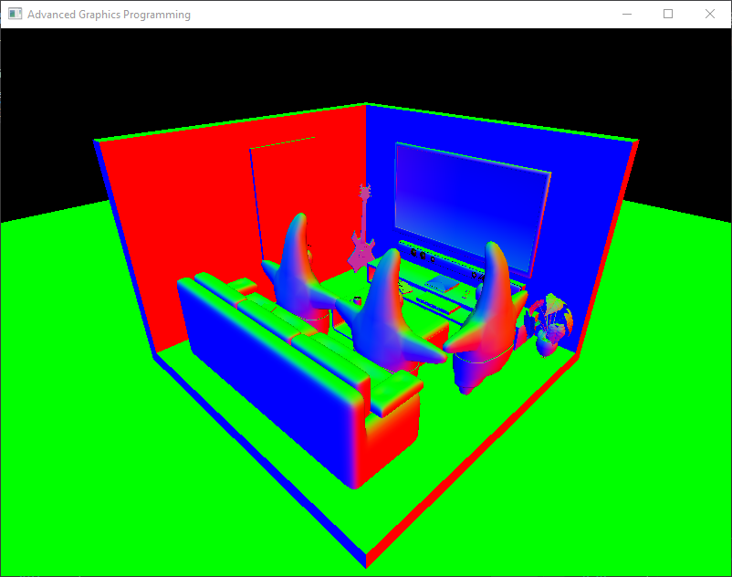
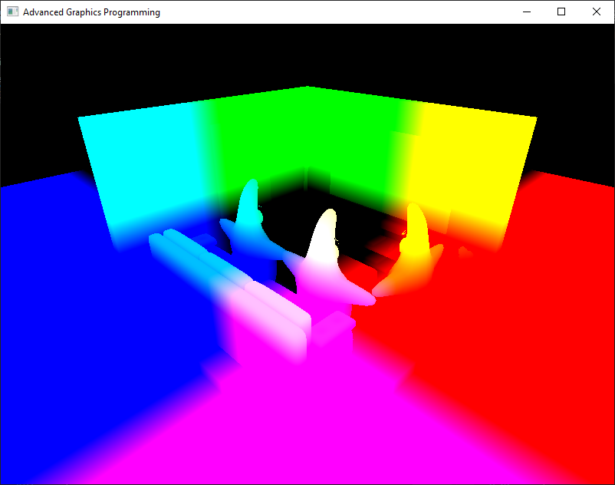
SSAO
World Normals
World Position
Screen-Space Normals
Screen-Space Position
Notes:
Input normals & position

Slide 5
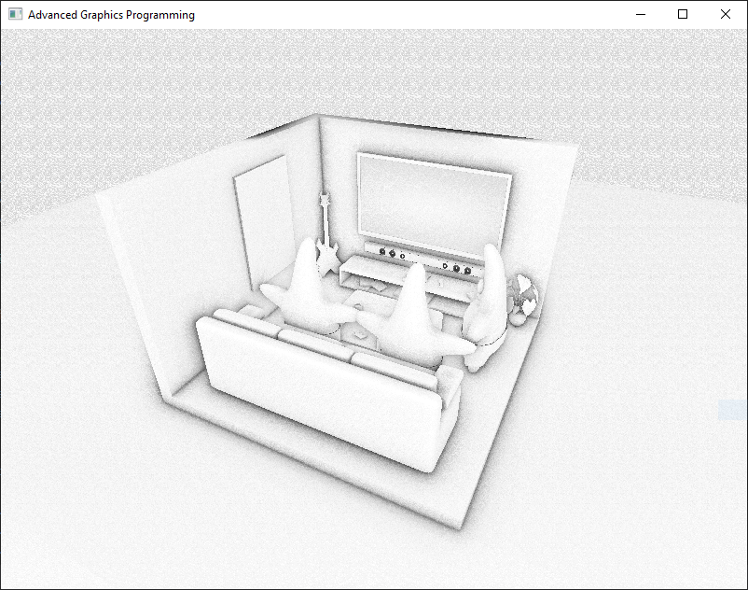
SSAO
Notes:
Sky artifact!!! -> 2 solutions:
1 more texture masking out sky or using depth texture

Slide 6
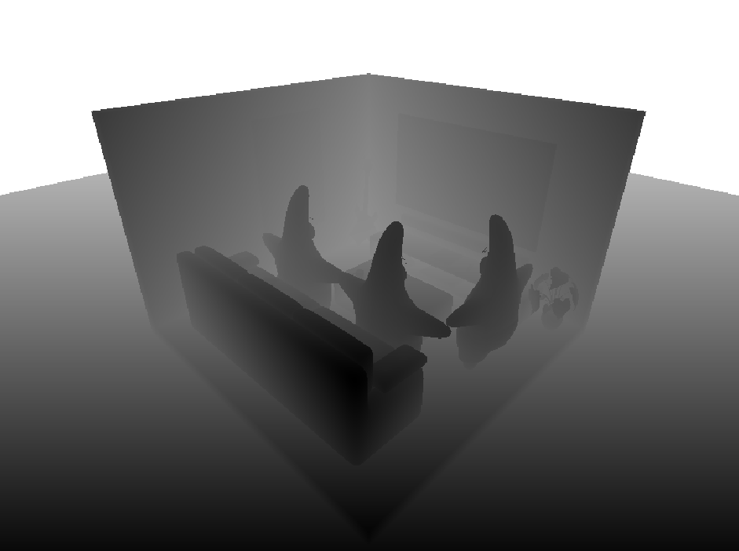
SSAO
World Normals
Non linear Depth
Screen-Space Normals
Linear Depth
Notes:
Use depth instead of position

Slide 7
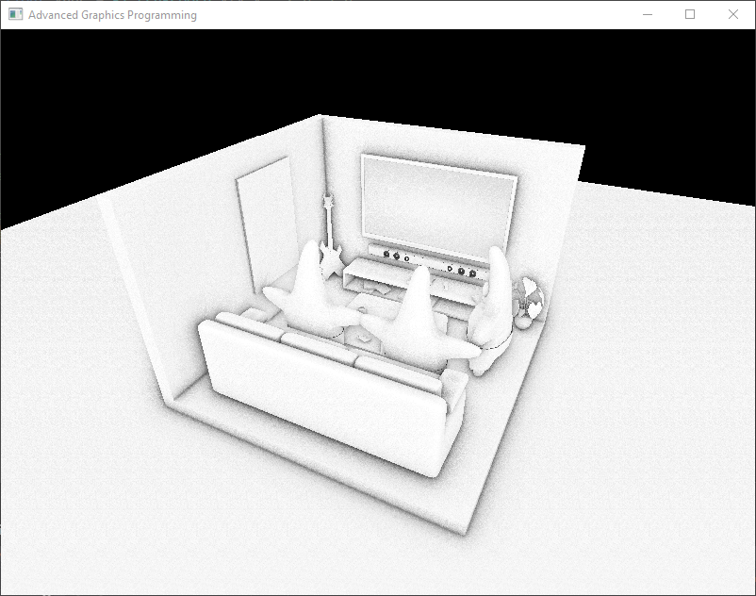
SSAO
Notes:
No sky artifacts

Slide 8
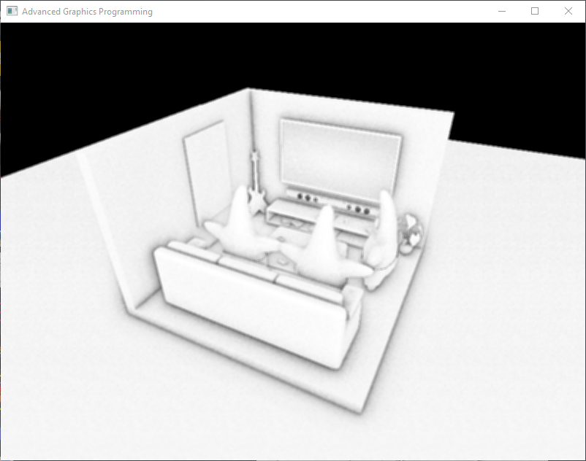
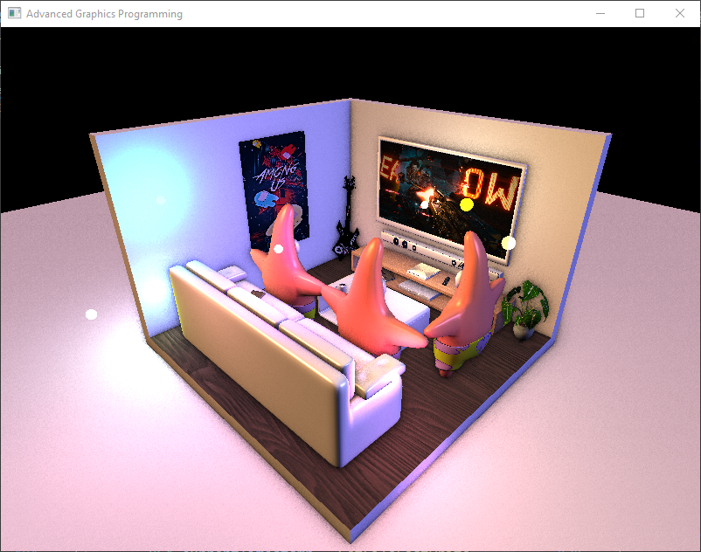

SSAO
Only SSAO
Applied to render
No blur
Blur

Slide 9
SSAO
Blur
Notes:
Artifacts around edges

Slide 10
SSAO
No blur
Notes:
No edge artifacts but a lot of noise

Slide 11
BLOOM

Slide 12
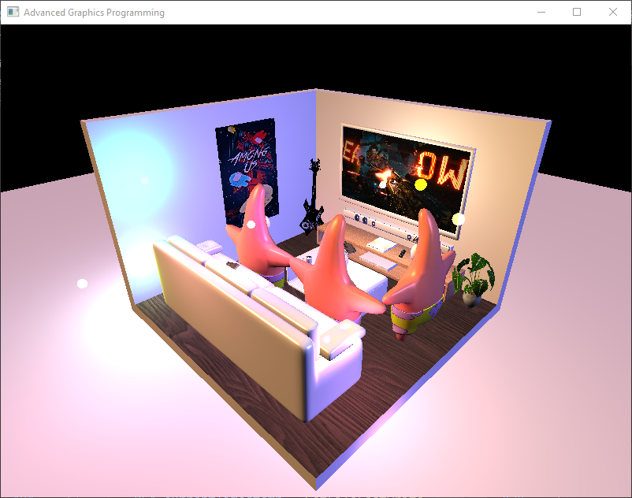
BLOOM
Base Render Color
Notes:
Input Base render color

Slide 13
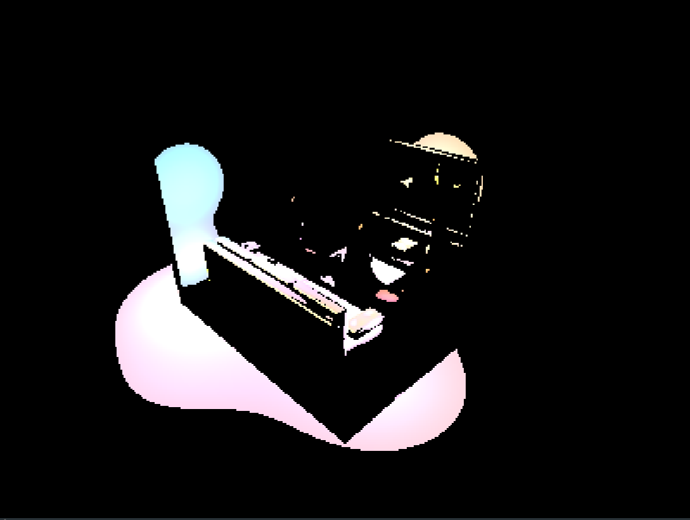
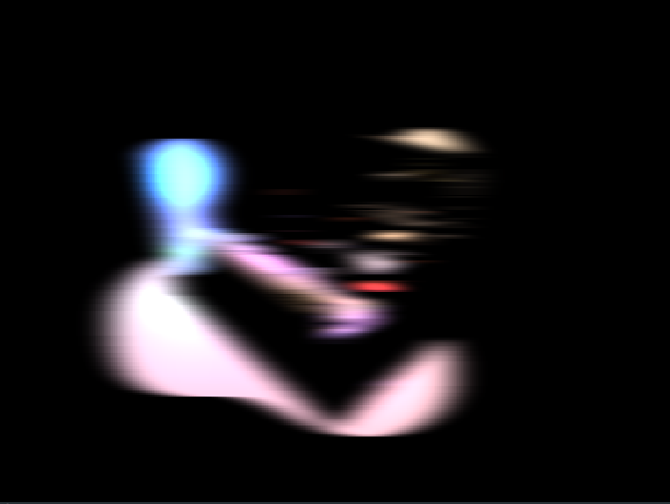

BLOOM
Extract brightest pixels
Horizontal Blur
Vertical Blur
…x5 LOD

Slide 14
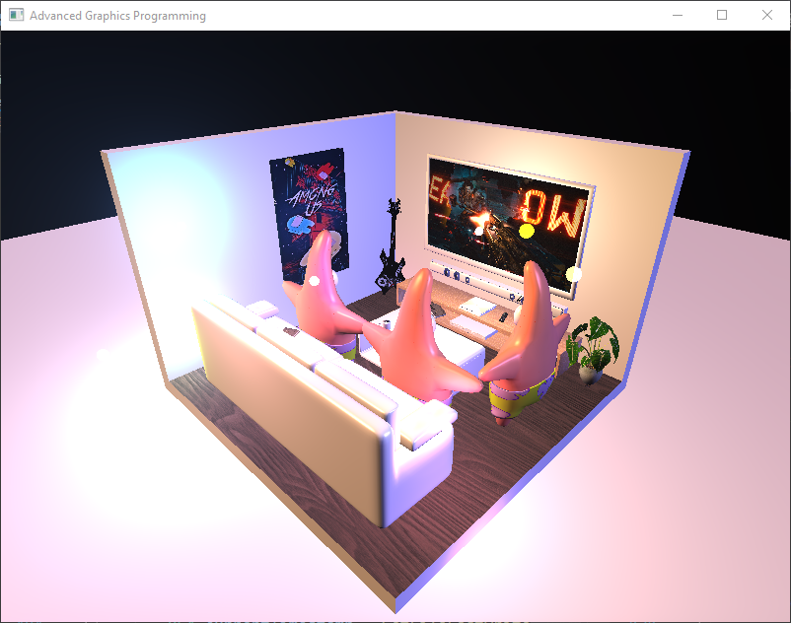
BLOOM
Notes:
Combine all LODs and merge with base image

Slide 15
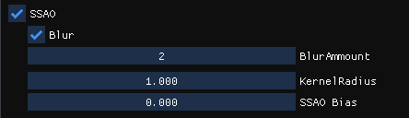
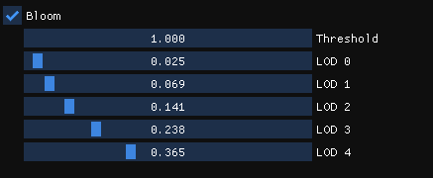
CUSTOMIZATION

Slide 16
RESULTS
Before

Slide 17
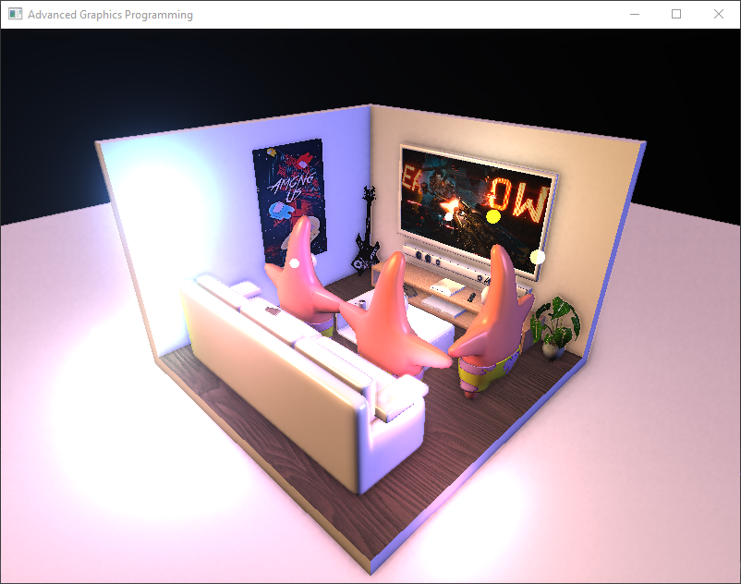
RESULTS
After (SSAO + BLOOM)

Slide 18
THANKS!
Do you have any questions?
Please keep this slide for attribution

